Slide 1
LIF111/101
Lecture 3: 03 January 2023
Mendelian inheritance and Meiosis
https://vimeo.com/22416575
Meiosis and continuity of life: a Frank Gregorio movie
©2005 Lee Bardwell

Slide 2
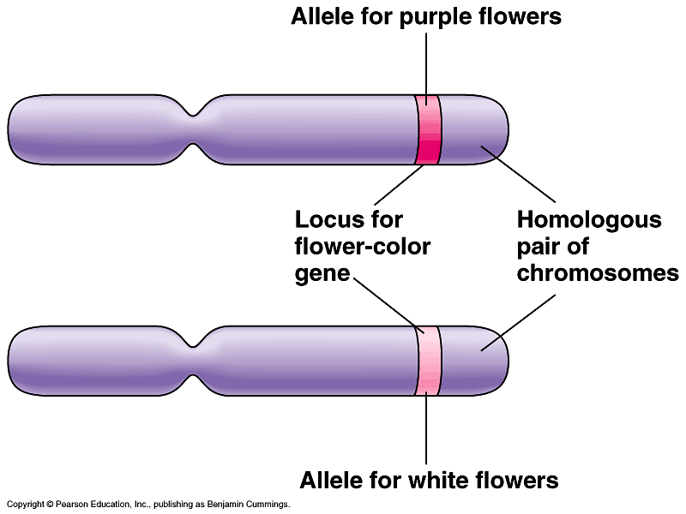
New Topic
Chromosomal basis of Mendelian inheritance
Mendel explained inheritance in pea in 1865 – it was not called a law in those days – it was hardly noticed. The physical basis of Mendelian inheritance was clear when chromosomes were discovered and their transmission in somatic cells (by Mitosis) and Gametes (Meiosis) was understood in the early 1900s
Summary of our current understanding

Slide 3
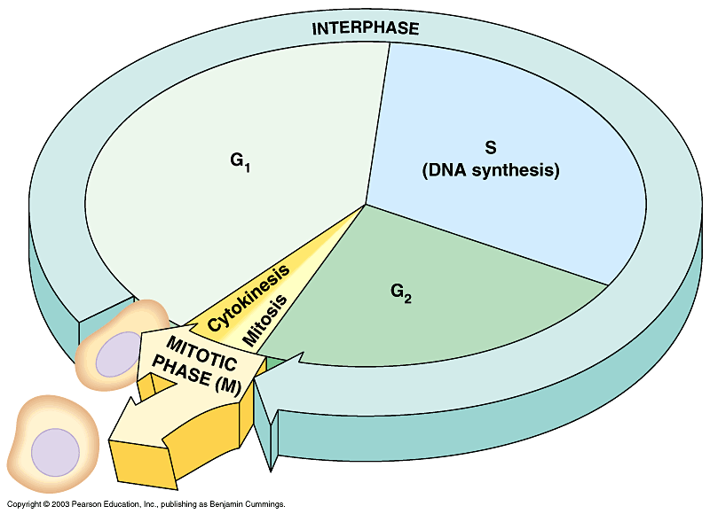
RECAP: The life cycle of a cell
Cell cycle consists of 2 major phases
  Interphase, where chromosomes duplicate
  and cell parts
  are made
  The mitotic
  phase, when
  nuclear division
  occurs
RECAP:

Slide 4
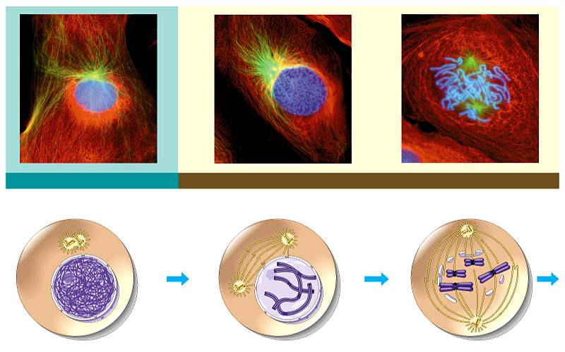
RECAP:
INTERPHASE
PROPHASE
Centrosomes
(with centriole pairs)
Early mitotic
spindle
Centrosome
Fragments
of nuclear
envelope
Kinetochore
Chromatin
Centrosome
Spindle
microtubules
Nucleolus
Nuclear
envelope
Plasma
membrane
Chromosome,
consisting of two
sister chromatids
Figure 8.6

Slide 5
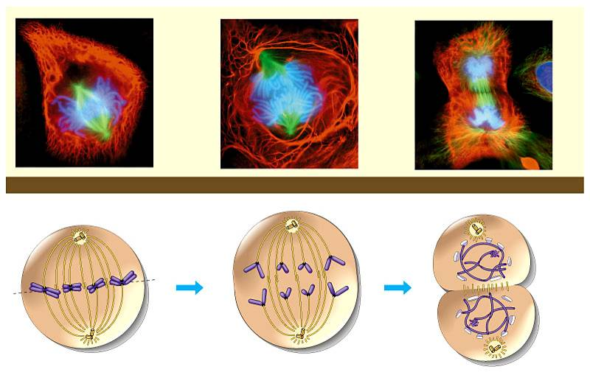
RECAP:
METAPHASE
ANAPHASE
TELOPHASE AND CYTOKINESIS
Metaphase
plate
Cleavage
furrow
Nucleolus
forming
Spindle
Daughter
chromosomes
Nuclear
envelope
forming
Figure 8.6 (continued)

Slide 6
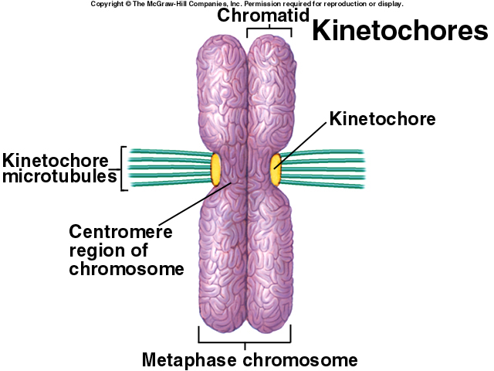
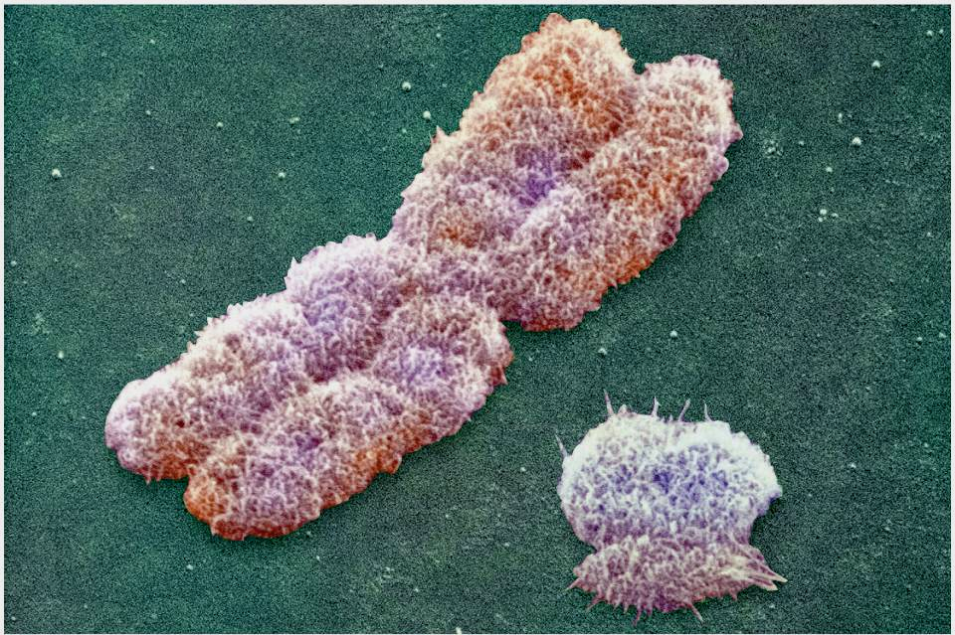
RECAP:
X chromosome

Slide 7
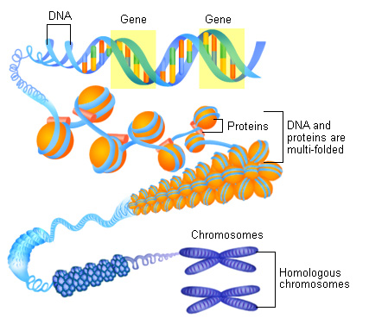
DNA, Chromatin and Chromosome
This is where we see chromosome as discrete entities under microscope

Slide 8
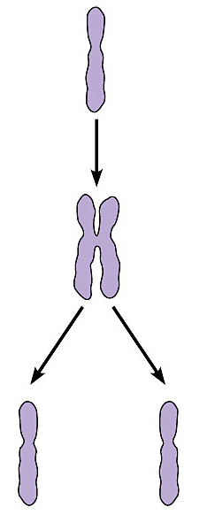
Mother
cell
When the cell divides, the sister chromatids separate
Chromosome
duplication
Centromere
Sister
chromatids
  Two daughter cells are produced
  Each has a complete and identical set of chromosomes
Daughter
cells
Chromosome
distribution
to
daughter
cells

Slide 9
Meiosis –
A process to generate haploid sets of chromosomes
Gamete carry haploid set of chromosomes

Slide 10
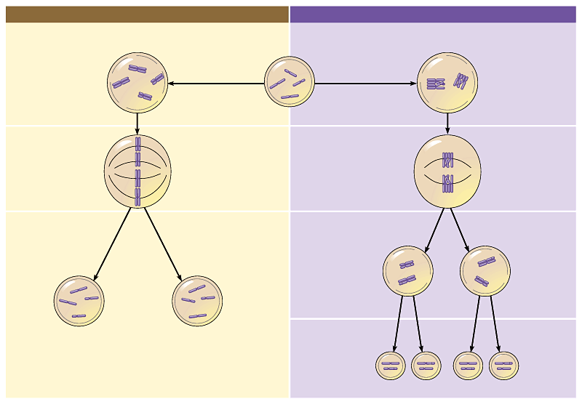
MITOSIS
MEIOSIS
MITOSIS
PARENT CELL
(before chromosome replication)
MEIOSIS
Site of
crossing over
PROPHASE
PROPHASE I
Tetrad formed
by synapsis of
homologous
chromosomes
Duplicated
chromosome
(two sister chromatids)
Chromosome
replication
Chromosome
replication
2n = 4
Chromosomes
align at the
metaphase plate
Tetrads
align at the
Metaphase plate
METAPHASE I
METAPHASE
ANAPHASE
TELOPHASE
Sister chromatids
separate during
anaphase
Homologous
chromosomes
separate
during
anaphase I;
sister
chromatids remain together
ANAPHASE I
TELOPHASE I
Haploid
n = 2
Daughter
cells of
meiosis I
2n
2n
No further chromosomal replication; sister chromatids separate during anaphase II
MEIOSIS II
Daughter cells
of mitosis
n
n
n
n
Daughter cells of meiosis II

Slide 11
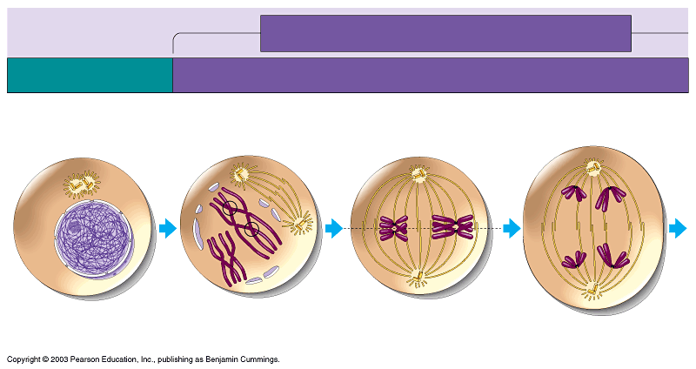
MEIOSIS I: Homologous chromosomes separate
INTERPHASE
PROPHASE I
METAPHASE I
ANAPHASE I
Centrosomes
(with
centriole
pairs)
Sites of crossing over
Microtubules attached to
kinetochore
Metaphase
plate
Sister chromatids
remain attached
Spindle
Nuclear
envelope
Chromatin
Sister
chromatids
Tetrad
Centromere
(with kinetochore)
Homologous
chromosomes separate
Note the separation of paired chromosomes and NOT that of chromatids

Slide 12
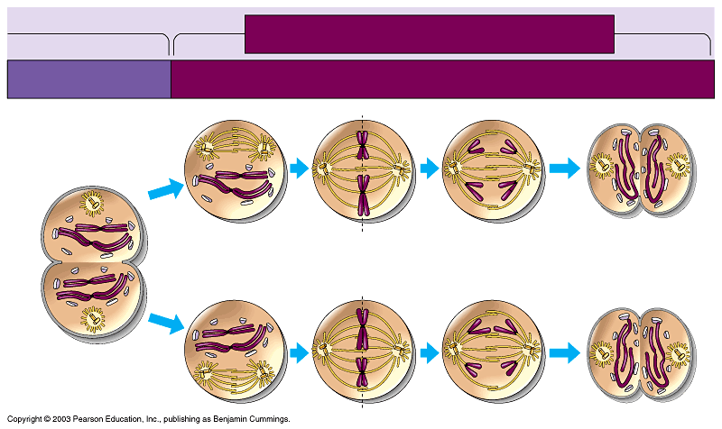
MEIOSIS II: Sister chromatids separate
TELOPHASE I
AND CYTOKINESIS
PROPHASE II
METAPHASE II
ANAPHASE II
TELOPHASE II
AND CYTOKINESIS
Cleavage
furrow
Sister chromatids
separate
Haploid
daughter cells
forming
This time chromatids separate
Figure 8.14, part 2

Slide 13
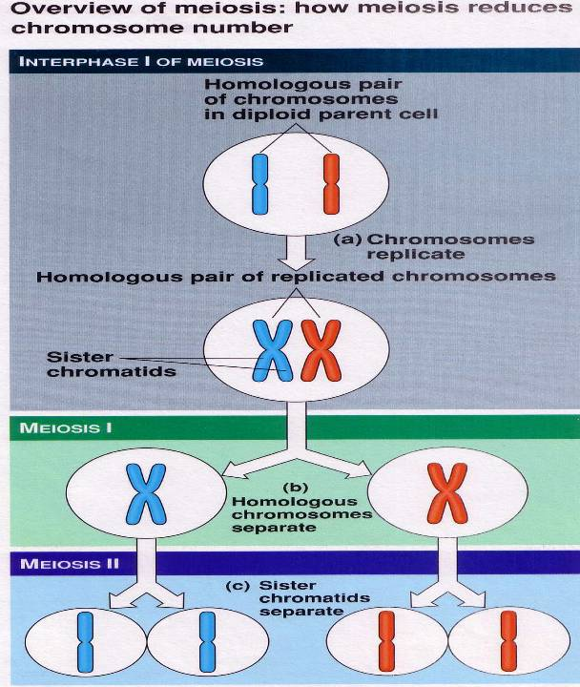

Slide 14
Gametes have a single set of chromosomes
Haploid gametes are produced by a special sort of cell division called meiosis
Which occurs only in reproductive organs, ovaries and testes
Purpose of meiosis is to produce sperm and egg and reduce the diploid set of chromosomes to a haploid set

Slide 15
MEIOSIS Hallmarks
Meiosis involves 2 cell divisions
Meiosis produces 4 cells from 1 parental cell
Each of the 4 daughter cells has 23 individual chromosomes rather than 23 pairs of chromosomes
Meiosis reduces the chromosome number from diploid to haploid
Meiosis, like mitosis, is preceded by chromosome duplication
  However, in meiosis the cell divides twice to form four daughter cells

Slide 16
Are these duplicated? Meaning already replicated
What replicates? Chromosome, DNA or both?

Slide 17
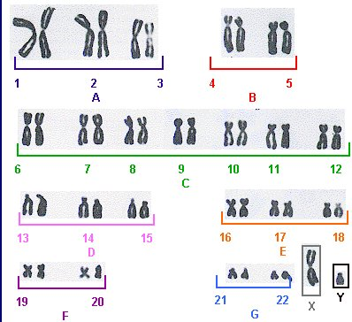
Which one is a chromosome and where are the chromatid?
How do we count chromosome number?
How many ‘sets’ of chromosomes are seen here?
Idea of diploid ‘2n’ and haploid ‘n’ sets
A karyotype (ORDERED ARRANGEMENT) of metaphase chromosomes ( in homologous pairs)

Slide 18
Goals of Pedigree Analysis
Determine the mode of inheritance: dominant, recessive, partial dominance, sex-linked, autosomal etc.
Determine the probability of an affected offspring for a given cross.

Slide 19
Symbols used in pedigree analysis:
Male
Sex
unspecified
Female
Affected
individuals
Mating
Heterozygotes
for autosomal recessive
Parents &
Children:
1 boy; 1 girl
(in order of birth)
Carrier of sex linked recessive
Death
Dizygotic
(non identical
Twins)
Abortion or still birth
Propositus
Monozygotic
(identical
Twins)
Consanguineous
marriage

Slide 20
Pedigree Analysis
Marriage
Normal female
Normal male
I
One these parent was therefore a carrier
1st born
II
Affected
Siblings
Is the mutant allele dominant or recessive?

Slide 21
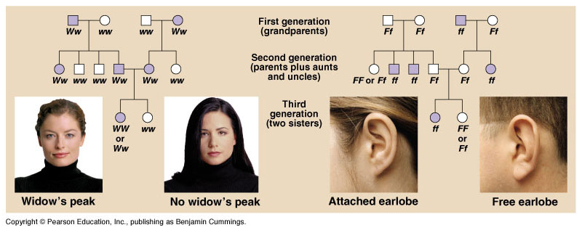
Pedigree Analysis

Slide 22
A Pedigree
Ww
ww
I
1
2
II
1
2
3
4
5
6
ww
ww
ww
Ww
Ww
Ww
III
1
2
3
4
5
6
7
8
9
10
ww
ww
ww
Ww
ww
ww
Ww
Ww
ww
Ww

Slide 23
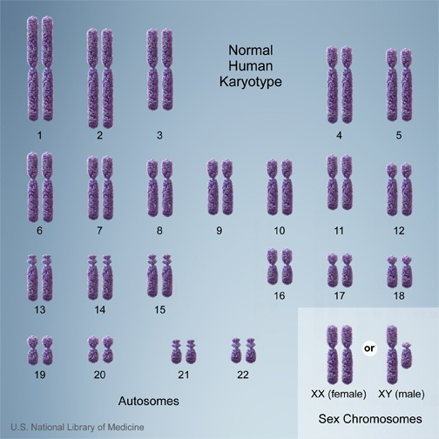
Sex-linked inheritance
The inheritance of genes located on the sex chromosome

Slide 24
Autosomal vs. sex-linked traits
Autosomal traits are caused by genes on autosomes (chromosome 1-22)
  autosomal recessive or dominant traits /diseases
Sex-linked traits are caused by genes on the sex chromosomes (X or Y)
  X-linked recessive or dominant traits /diseases

Slide 25
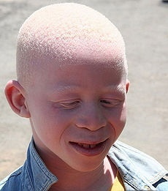
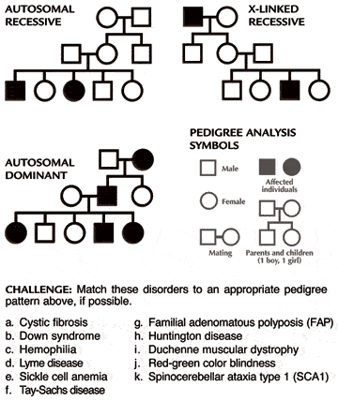
Albinism :
Autosomal recessive inheritance
Why this inheritance is called autosomal?

Slide 26
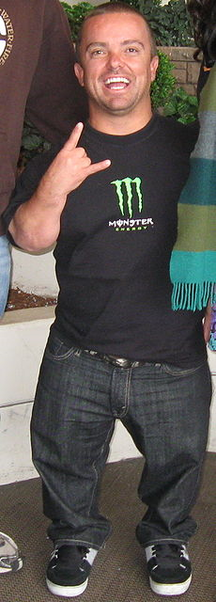
Achondroplasia:
Autosomal dominant inheritence
Why this called autosomal dominant dominant ?

Slide 27
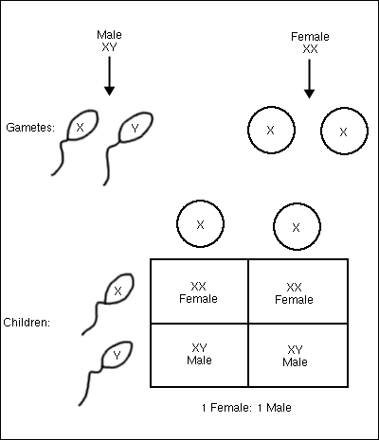
Sex Determination in humans
Parents

Slide 28
In such an inheritance pattern what is the ready sign of sex-linkage?
Father
X_{A}Y
X_{A}
Y
Daughter
XX_{A}
Son
XY
X
Mother
affected
normal
X X
Son
XY
Daughter
XX_{A}
X
affected
normal
X-linked dominant

Slide 29
Female carrier* mates with normal male
X-linked recessive disease
F x M
X_{N}X_{A} X_{N}Y
Sperm
X_{N}
Y
F
X_{N}X_{N}
M
X_{N}Y
X_{N}
normal
normal
Eggs
F
X_{A}X_{N}
M
X_{A}Y
X_{A}
carrier
affected
Half* her daughters will be carriers
Half* her sons will be affected
*on average

Slide 30
Affected male mates with normal female
X-linked recessive disease
F x M
X_{N}X_{N} X_{A}Y
Sperm
X_{A}
Y
F
X_{N}X_{A}
M
X_{N}Y
X_{N}
carrier
normal
Eggs
F
X_{N}X_{A}
M
X_{N}Y
X_{N}
carrier
normal
All his daughters will be carriers
None of his sons will be affected

Slide 31
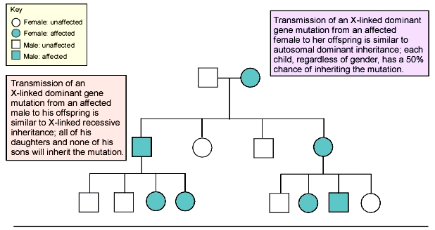
Pedigree Illustrating Inheritance Pattern of an X-Linked dominant mutation

Slide 32
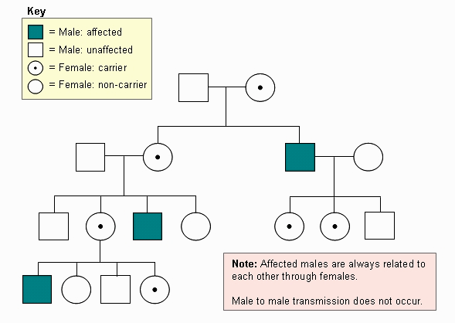
Pedigree Illustrating X-Linked Recessive Inheritance Pattern
Great grand mother
Grand mother
Nani
Grand Uncle
Grand daughter
Uncle (mama)
Nephew

Slide 33
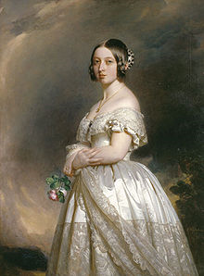
Hemophilia : X-linked recessive
Empress of India 1876
Queen Victoria (1819-1901)
passed haemophilia A
on to many of her descendants

Slide 34
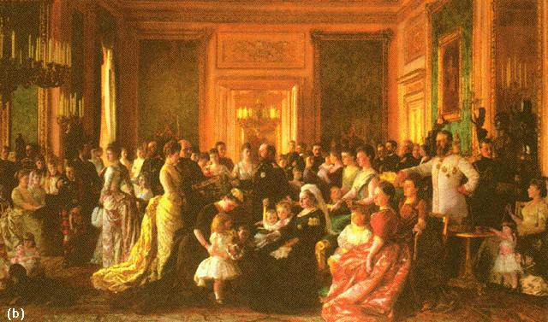
Hemophilia: The Royal Disease
The inheritance of the X-linked recessive condition hemophilia in the royal families of Europe

Slide 35
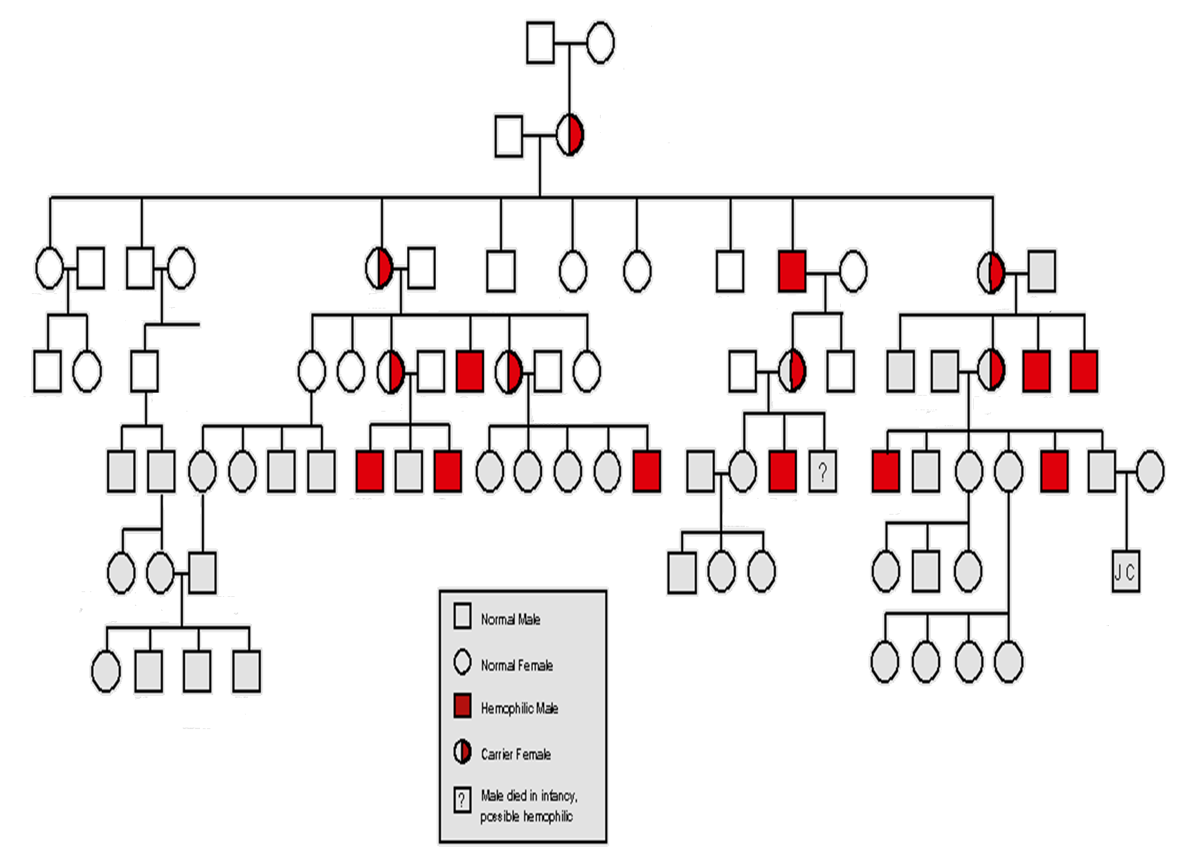
Edward
(Duke of Kent)
Victoria
(Princess of Saxe-Coburg)
Albert
Victoria
(Queen of England)
Alice
Arthur
Victoria
Frederick
Louis
Alfred
Helena
Louise
Leopold
Helen
Beatrice
Henry
Wihelm II
Sophie
George V
Alix
Nikolas II of Russia
Alfonso XII Spain
Eugenic
George VI
Waldemar
Henry
Alexic
Alfonso
Gonzalo
Queen Elizabeth
Prince Philip
Normal Male
Normal Female
Hemophilic Male
Carrier Female
?
Male died in infancy
Possible hemophilic

Slide 36
Some X-linked recessive human diseases
Hemophilia A
Hemophilia B
Red-green color blindness
Duchenne muscular dystrophy
Retinitis pigmentosum (one of many loci)
Lesch-Nyhan Syndrome
Many others

Slide 37
Some X-linked dominant human diseases
Incontinentia Pigmenti
Hypophosphatemic Rickets
Charcot-Marie-Tooth disease
Chondrodysplasia Punctata

Slide 38
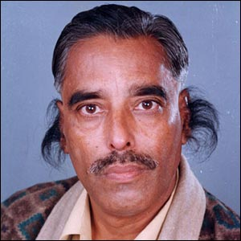

Hypertrichosis pinnae auris : Y-linked
XY
XX
XX
XY
XX
XX
XY
XY
XX
XX
XX
XY
XY
As only males have a Y chromosome, the genes are simply passed from father to son. Every son of the father will be affected. Very few Y-linked disorders are know except infertility

Slide 39
Problems and examples of chromosomal inheritance

Slide 40
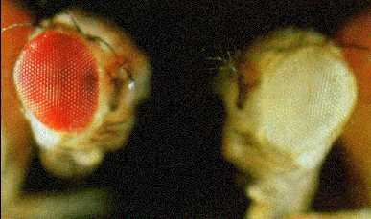
Inheritance of eye coloration in fruit fly, Drosophila:
An example of sex-linked inheritance
Normal Red
Mutant white

Slide 41
First : Observe
No eye coloration : white eyed
Normal eye coloration : red eyed
How do we name the gene and what are its alleles??
Gene name white
Normal Allele : white (+) red pigmentation
Mutant allele : white no pigmentation
Which one is recessive and which one is dominant?

Slide 42
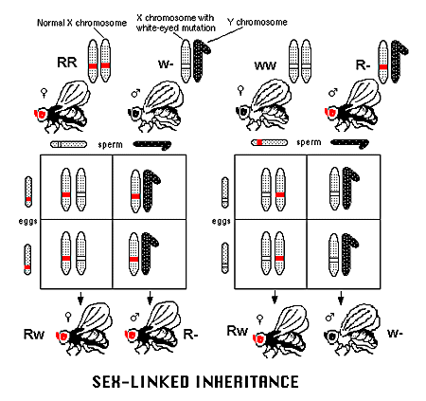
Then test and infer
W
w w
W+
w+w+
w
w+w
w+w
w+w

Slide 43
Problem
A yellow body-colored female fruit fly was mated to a male with normal body color (brown).
All the female progeny were brown (normal) while all the male progeny were yellow. What does this inheritance pattern signify?
Solve this problem

Slide 44
Significance of chromosome numbers in in heritance
What if individual chromosomes do not separate during meiosis? Error in chromosome number

Slide 45
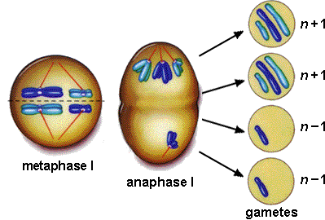
The Culprit: Non-disjunction
Older women are more likely than younger women to evidence chromosome damage and meiotic irregularities

Slide 46
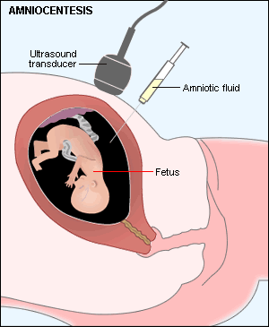
Pre-natal Diagnosis: Amniocentesis
Will it be possible to detect a defective gene by amniocentesis?
Fetal cells present in amniotic fluid are then cultured and analyzed for chromosomes (karyotyping) and other biochemical tests

Slide 47
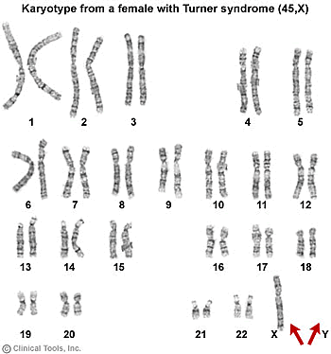
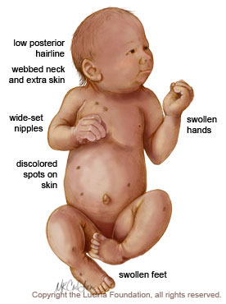
This baby has one X chromosome. Yet it is a female baby. Why?
Monosomy: Turner’s Syndrome: 44+X

Slide 48
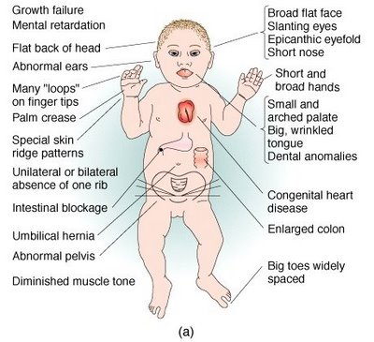
Individual chromosome segregation going wrong during meiosis
Why down’s syndrome does not suggest abnormal sex linked inheritance?
How can errors in chromosomal segregation result in Down’s syndrome?
Trisomy of chromosome . 21: Down’s
Syndrome: 45+XY/45+XX
Other disorders: Trisomy-13 (47:+13), Trisomy-18 (47:+18),
Klinefelter Syndrome (44+XXY), Triple X syndrome (44+XXX), XYY trisomy (44+XYY)

Slide 49


People suffering from Down syndrome can lead a reasonably normal life

